Slide 1


<Name>
<Date>

Slide 2

Outline
Executive Summary
Introduction
Methodology
Results
Conclusion
Appendix

Slide 3

Executive Summary
Problem in this project is how to determine price for each launch, therefore we can estimate the cost.
To handle the problem, we need to collected the dataset from SPACEX REST API and scrapping, then we need to wrangling the data (process the data). After we process the data, we analyzed the data using visualization (visualize with dashboard, and using folium to visualize the map of data) and SQL query. After that we make a classification model, in this case we proposed 4 classification model:
KNN
SVM
Decision Tree
Logistic Regresion
We found that Decision Tree has the best accuracy which 87%.

Slide 4



Introduction
SPACEX is the most successful company that provide space travel for everyone. SPACEX accomplishments are:
Sending space craft to space
Starlink project
Sening human to space

Slide 5

Introduction
SPACEX can only cost 62 million dollars for its Falcon 9 rocket launches meanwhile other providers cost upwards of 165 million dollars each. The problem is:
How to determine the price for each launch ?
Solution for this problem is we can use data to predict and determine the cost for each launch by gathering and analysis information about SPACEX parameters like payload, customers, etc

Slide 6

Section 1

Slide 7
Methodology
Executive Summary
Data collection methodology:
Collected from SPACEX REST API and scrapping
Perform data wrangling
Perform exploratory data analysis (EDA) using visualization and SQL
Perform interactive visual analytics using Folium and Plotly Dash
Perform predictive analysis using classification models

Slide 8

Data Collection
The dataset is gathered from an API (SPACEX REST API). This API give us information about:
Launches
Rockets Used
Payload Delivered
Launch Specifications
Landing Specifications
Landing Outcome

Slide 9
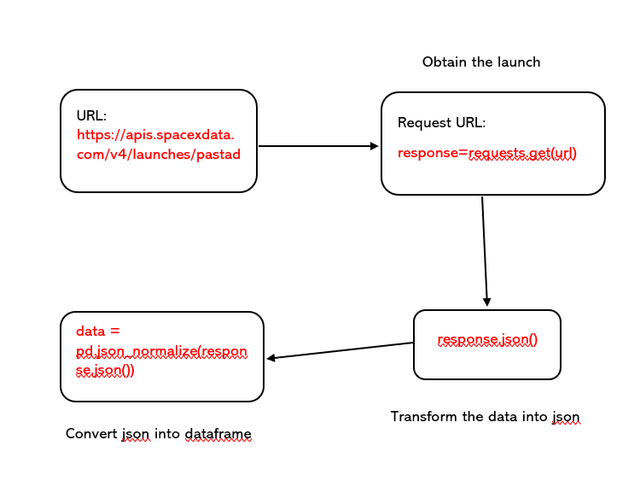
Data Collection – SpaceX API
Here is the how to process the data collection from SPACEX REST API
Github link for REST API:
https://github.com/lixx21/IBM-Data-Science-Capstone/blob/main/WEEK%201/jupyter_labs_spacex_data_collection_api.ipynb

Slide 10
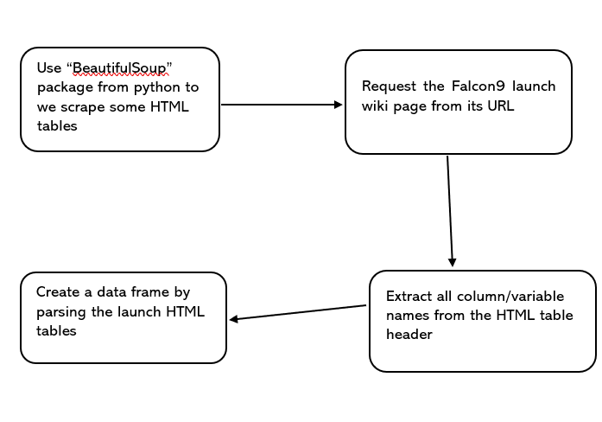
Data Collection - Scraping
Web scraping process is shown at the right side.
Github link for this scraping:
https://github.com/lixx21/IBM-Data-Science-Capstone/blob/main/WEEK%201/jupyter_labs_webscraping.ipynb
Place your flowchart of web scraping here

Slide 11
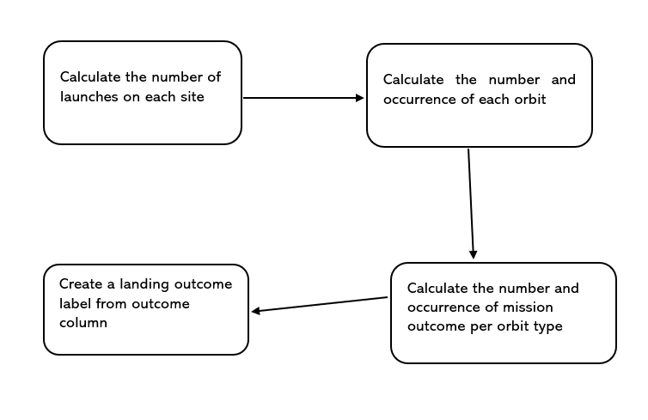
Data Wrangling
In data wrangling we want to transform the raw data into a clean dataset which provides a meaningful data on the situation we are trying to address. We want to do several things like:
Wrangling data using an API
Sampling data
Dealing with nulls
Data wrangling process
Github link:
https://github.com/lixx21/IBM-Data-Science-Capstone/blob/main/WEEK%201/labs_jupyter_spacex_Data_wrangling.ipynb

Slide 12
EDA with Data Visualization
To visualize relationship between flight number and launch site, payload and launch site, flight number and orbit type, and payload and orbit type we using scatter plot. The reason why we used scatter plot, because scatter plot is use to determine correlation between 2 variable exists
To visualize relationship between success rate of each orbit type, we used bar chart. It is because we want to compare the values of a variable at a given point time
To visualize the launch success yearly trend, we used line chart, because we want to visualize the continues data over a period of time
Github: https://github.com/lixx21/IBM-Data-Science-Capstone/blob/main/WEEK%202/jupyter_labs_eda_dataviz.ipynb

Slide 13
EDA with SQL
All queries that were used:
SELECT * FROM SPACEXTBL Limit 10
SELECT DISTINCT Launch_Site FROM SPACEXTBL
SELECT Launch_Site FROM SPACEXTBL WHERE Launch_Site LIKE 'CCA%' LIMIT 5
SELECT COUNT(PAYLOAD_MASS__KG_) FROM SPACEXTBL WHERE Customer = 'NASA (CRS)’
SELECT AVG(PAYLOAD_MASS__KG_) FROM SPACEXTBL WHERE Booster_Version = 'F9 v1.1’
SELECT MIN(Date) FROM SPACEXTBL WHERE "Landing _Outcome" = 'Success (ground pad)’
Github: https://github.com/lixx21/IBM-Data-Science-Capstone/blob/main/WEEK%202/jupyter_labs_eda_sql_coursera_sqllite.ipynb

Slide 14
EDA with SQL
SELECT Booster_Version, PAYLOAD_MASS__KG_ FROM SPACEXTBL WHERE "Landing _Outcome" = 'Success (drone ship)' and PAYLOAD_MASS__KG_ > 4000 and PAYLOAD_MASS__KG_ < 6000
SELECT COUNT(Mission_Outcome) FROM SPACEXTBL WHERE Mission_Outcome LIKE 'Success%’
SELECT COUNT(Mission_Outcome) FROM SPACEXTBL WHERE Mission_Outcome LIKE 'Failure%’
SELECT Booster_Version FROM SPACEXTBL WHERE PAYLOAD_MASS__KG_ = (select MAX(PAYLOAD_MASS__KG_) from SPACEXTBL)
SELECT substr(Date,4,2) "Landing _Outcome", Booster_Version, Launch_Site FROM SPACEXTBL WHERE "Landing _Outcome" LIKE 'Failure%' and SUBSTR(DATE,7,4)='2015’
SELECT COUNT("Landing _Outcome"), "Landing _Outcome" FROM SPACEXTBL WHERE Date between '04-06-2010' and '20-03-2017' GROUP BY("Landing _Outcome") ORDER BY("Landing _Outcome") DESC
Github: https://github.com/lixx21/IBM-Data-Science-Capstone/blob/main/WEEK%202/jupyter_labs_eda_sql_coursera_sqllite.ipynb

Slide 15
Build an Interactive Map with Folium
Map objects that used in this project is marker, circle and polyline
I used circle object because I want to add a highlighted circle area with a text label on a specific coordinate
Marker is used to mark the coordinate with an icon
Polyline is used to created marker distance between launch site and coastline point
Github: https://github.com/lixx21/IBM-Data-Science-Capstone/blob/main/WEEK%203/lab_jupyter_launch_site_location.ipynb

Slide 16
Build a Dashboard with Plotly Dash
In dashboard I added dropdown list for launch site, pie chart, slider, scatter plot and callback
I added dropdown list thus users can find launch site that they want easily
I added pie chart to visualize successful launches count based on what launch site that users choose in dropdown list
I added slider for users to select payload range
I added scatter plot to visualize correlation between payload and launch success
Callback function is used to call dropdown list and payload slider as an input, then pie chart and scatter plot as an output
Github: https://github.com/lixx21/IBM-Data-Science-Capstone/blob/main/WEEK%203/spacex_dash_app.py

Slide 17
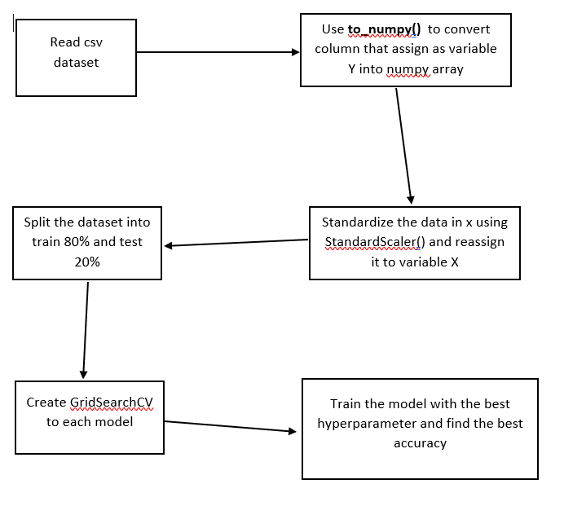
Predictive Analysis (Classification)
I built 3 classifier model which SVM, KNN, Decision Tree and Logistic Regression, I find the best hyperparameter for those model by using GridSearchCV.
Github: https://github.com/lixx21/IBM-Data-Science-Capstone/blob/main/WEEK%204/SpaceX_Machine_Learning_Prediction_Part_5.ipynb

Slide 18
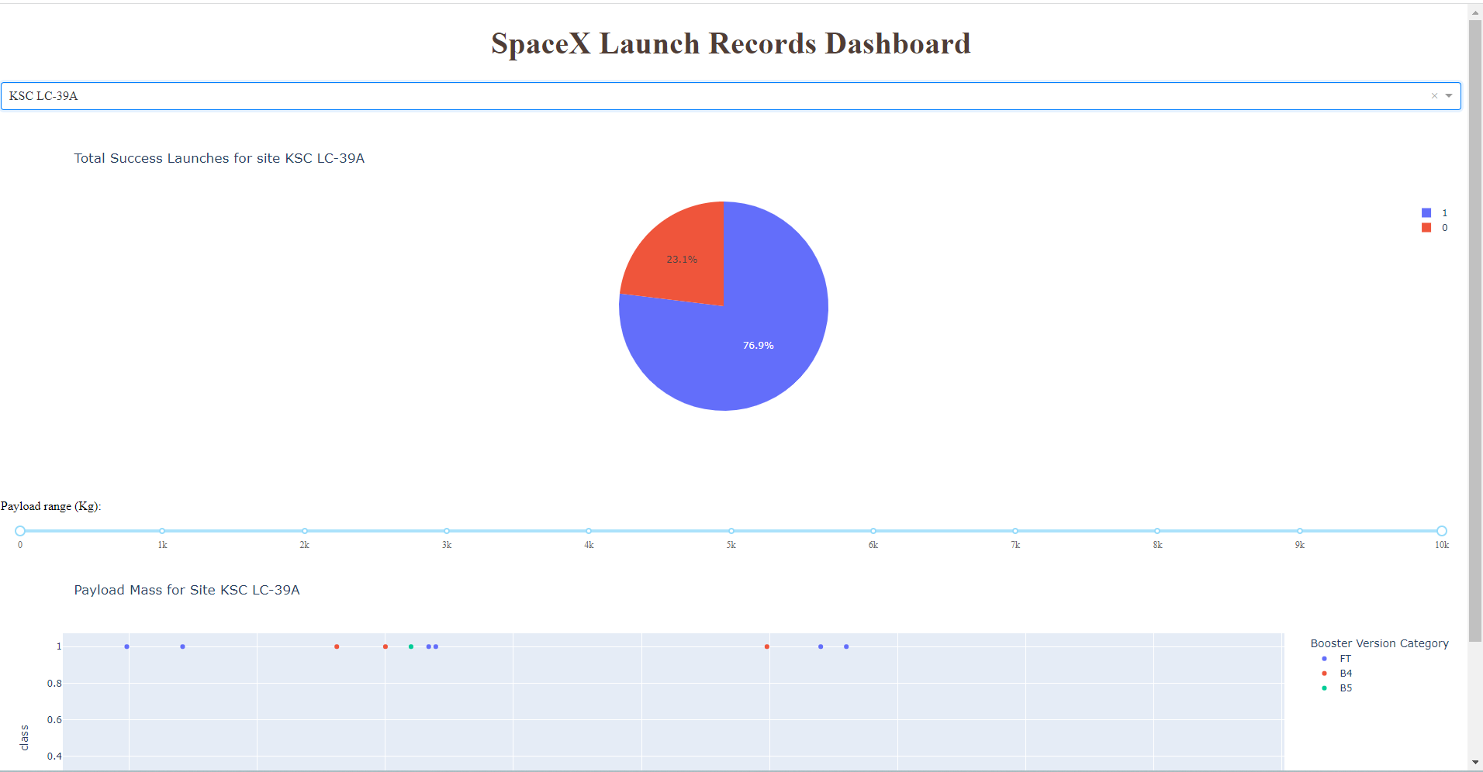
Results
Exploratory data analysis results:
There is 4 distinct launch site (CCAFS LC-40, VAFB SLC-4E, KSC LC-39A, CCAFS SLC-40)
In landing outcome, there is 6 success (ground pad), 8 success (drone ship), 20 Success, 11 no attempt, 2 failure (parachute), 4 failure(drone ship), 3 failure, 3 controlled (ocean)
etc
Result of predictive analysis is:
Logistic regression: 84%
SVM: 84%
Decision Tree: 87%
KNN: 84%
Interactive dashboard

Slide 19

Section 2

Slide 20
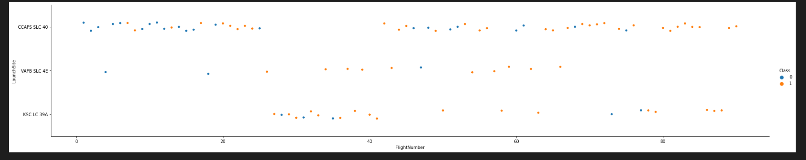
Flight Number vs. Launch Site
The scatter plot shows the correlation between Flight Number and Launch Site
As we can see, that launch site is Y variable and Flight Number is X variable.
CCAFS SLC-40 has the most flight number, and VAFB SLC-4E has the least flight number
There is 2 class shown in plot, class 0 in blue color, and 1 in orange color

Slide 21
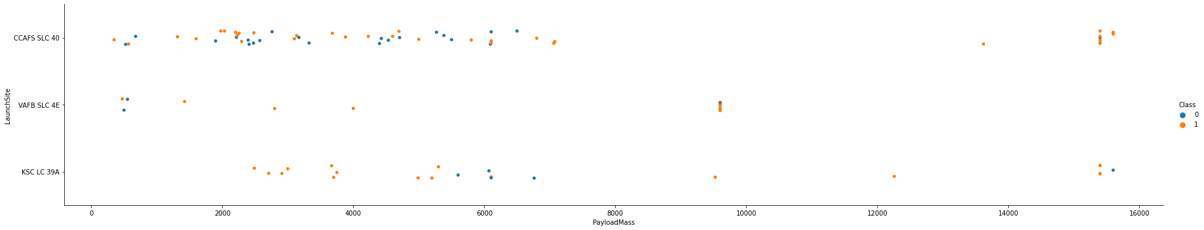
Payload vs. Launch Site
The scatter plot shows the correlation between Payload and Launch Site
Y = Launch Site, X = Payload
The plot shows that VAFB SLC-40 has no payload more than 10000
CCAFS SLC-4 has the most class between Payload and Launch Site

Slide 22
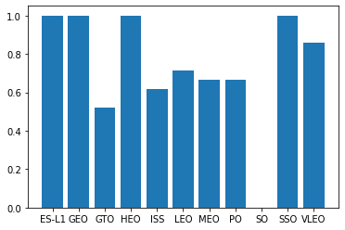
Success Rate vs. Orbit Type
To visualize this case, I used bar plot because we want to compare 2 variables
X = Orbit Type, Y = Success Rate
SO orbit type does not have success rate
ES-L1, GEO, HEO and SSO success rate is 1 or 100%

Slide 23
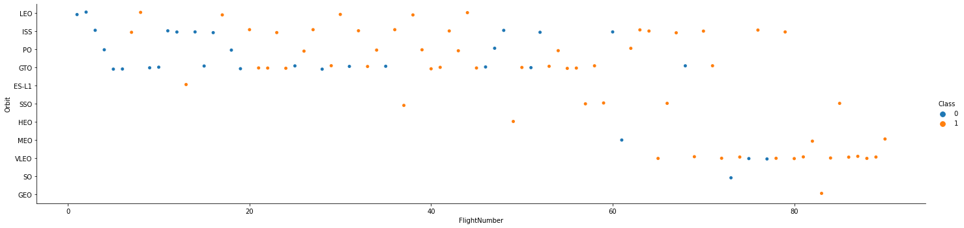
Flight Number vs. Orbit Type
Scatter plot is used because I want to find the correlation between Flight Number and Orbit Type
X = Flight Number, Y = Orbit Type
There is no Flight Number in MEO, VLO, SO and GEO that have Flight Number less than 60
SO and GEO only have 1 Flight Number

Slide 24
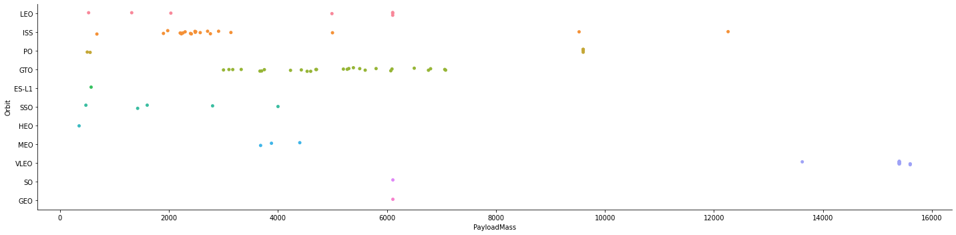
Payload vs. Orbit Type
Scatter plot is used because I want to find the correlation between Flight Number and Orbit Type
X = Payload Mass, Y = Orbit Type
SO and GEO only have 1 payload mass in approximately 6200

Slide 25
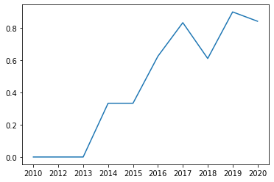
Launch Success Yearly Trend
Line plot is used to see continues data over period of time
X = Year, Y = Success Rate
As we can see that from 2010 to 2017 the trend is kept increasing
In 2018 trend is down again and up in 2019. In 2020 trend is down in approximately 80% success rate
This is tell us that success rate from 2010 until 2020 has a significant increased

Slide 26
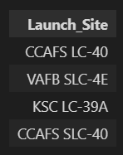
All Launch Site Names
Unique launch site names is shown at the right side with query:
%sql SELECT DISTINCT Launch_Site FROM SPACEXTBL
I used DISTINCT in here to find unique value in the column

Slide 27
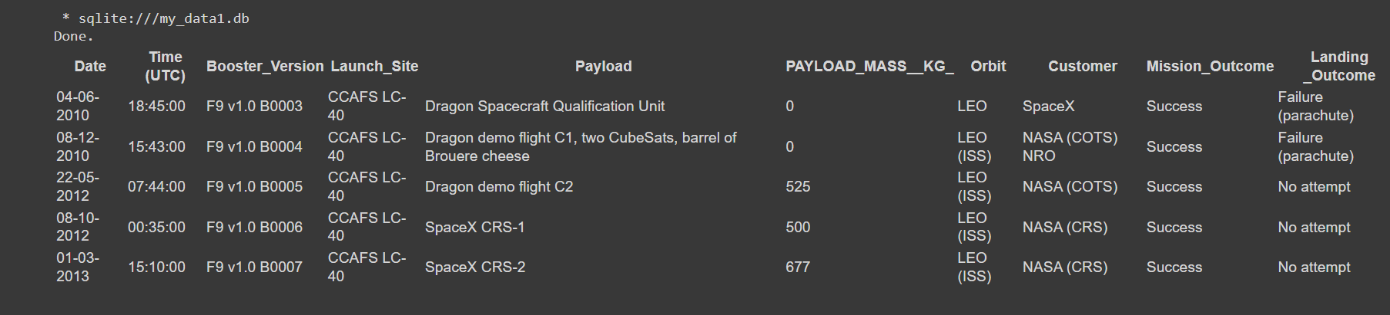
Launch Site Names Begin with 'CCA'
Query:
%sql SELECT * FROM SPACEXTBL WHERE Launch_Site LIKE 'CCA%' LIMIT 5
LIKE is used to get a specific character that we want from data and % after the character determine that we want take the first letter
LIMIT 5 is used to take only 5 records

Slide 28
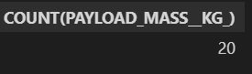
Total Payload Mass
Query:
%sql SELECT COUNT(PAYLOAD_MASS__KG_) FROM SPACEXTBL WHERE Customer = 'NASA (CRS)'
COUNT function used to count how many rows in column payload
Add WHERE for conditional, therefore the query only count how many rows in column payload where customers equals to ‘NASA (CRS)’

Slide 29
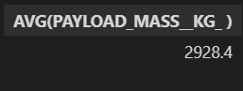
Average Payload Mass by F9 v1.1
Query:
%sql SELECT AVG(PAYLOAD_MASS__KG_) FROM SPACEXTBL WHERE Booster_Version = 'F9 v1.1'
AVG() is used to find average from value in payload column
WHERE is to specify the condition

Slide 30
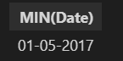
First Successful Ground Landing Date
Query:
%sql SELECT MIN(Date) FROM SPACEXTBL WHERE "Landing _Outcome" = 'Success (ground pad)'
MIN() is used to find the first date in landing outcome with condition where landing outcome is equal “Success (ground pad)”

Slide 31
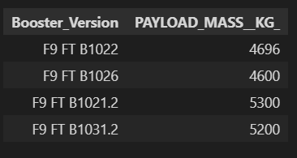
Successful Drone Ship Landing with Payload between 4000 and 6000
Query:
%sql SELECT Booster_Version, PAYLOAD_MASS__KG_ FROM SPACEXTBL WHERE "Landing _Outcome" = 'Success (drone ship)' and PAYLOAD_MASS__KG_ > 4000 and PAYLOAD_MASS__KG_ < 6000
There is 3 conditional in this case, therefore we use AND to handle this case.

Slide 32
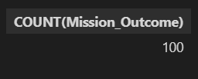
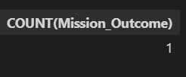
Total Number of Successful and Failure Mission Outcomes
Number Success Mission
Number Failure Mission
%sql SELECT COUNT(Mission_Outcome) FROM SPACEXTBL WHERE Mission_Outcome LIKE 'Success%'
%sql SELECT COUNT(Mission_Outcome) FROM SPACEXTBL WHERE Mission_Outcome LIKE 'Failure%'

Slide 33
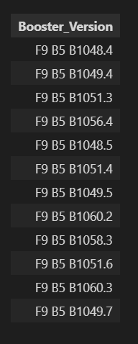
Boosters Carried Maximum Payload
Query:
%sql SELECT Booster_Version FROM SPACEXTBL WHERE PAYLOAD_MASS__KG_ = (select MAX(PAYLOAD_MASS__KG_) from SPACEXTBL)

Slide 34
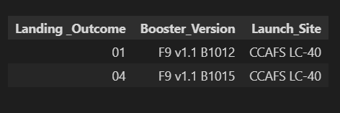
2015 Launch Records
Query:
%sql SELECT substr(Date,4,2) "Landing _Outcome", Booster_Version, Launch_Site FROM SPACEXTBL WHERE "Landing _Outcome" LIKE 'Failure%' and SUBSTR(DATE,7,4)='2015'
Substr(Date,4,2) here is used to determine date
Substr(Date,7,4) here is used to determine year

Slide 35
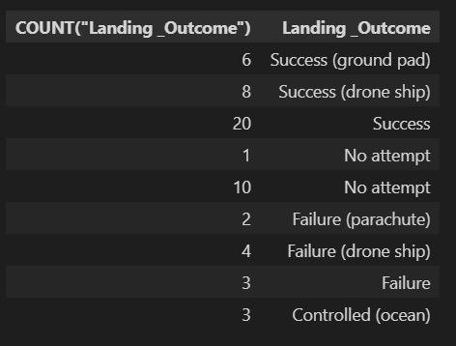
Rank Landing Outcomes Between 2010-06-04 and 2017-03-20
Query:
%sql SELECT COUNT("Landing _Outcome"), "Landing _Outcome" FROM SPACEXTBL WHERE Date between '04-06-2010' and '20-03-2017' GROUP BY("Landing _Outcome") ORDER BY("Landing _Outcome") DESC

Slide 36

Section 3

Slide 37
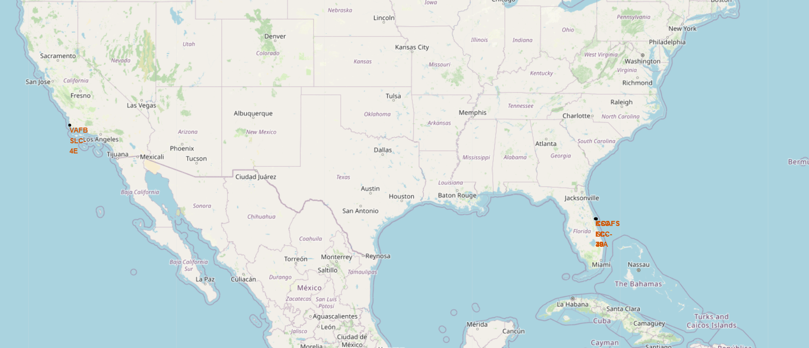
Mark All Launch Sites on Map
To mark all of launch sites, I used circle and marker
I used coordinate of the launch site in dataframe, by using latitude and longitude in the datframe: coordinate = [row[‘lat], row[‘long’]]

Slide 38
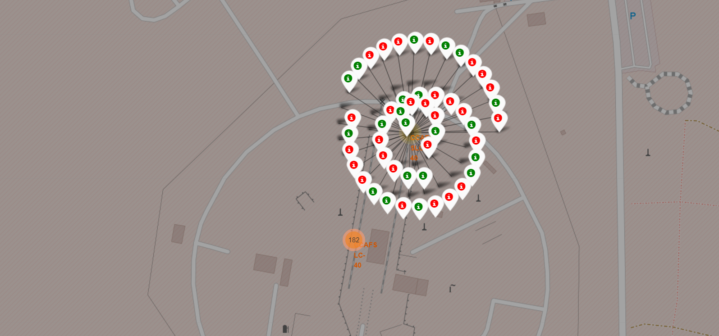
Mark the success/failed launches for each site on the map
To mark success/failed for all launch sites, I used MarkerCluster() and folium.marker()
Green marker on the map shows that launches success, and red otherwise

Slide 39
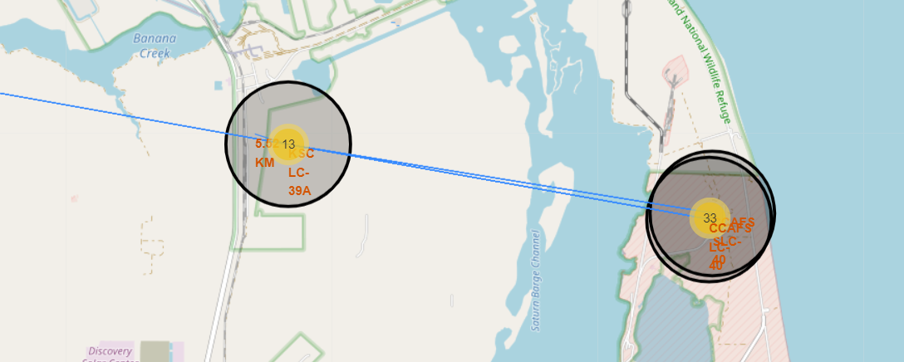
Calculate the distances between a launch site to its proximities
Calculate distance with parameters (lat1, long1, lat2, long2)
Formula:
a = sin(dlat / 2)**2 + cos(lat1) * cos(lat2) * sin(dlon / 2)**2
c = 2 * atan2(sqrt(a), sqrt(1 - a))
distance = R * c
R = 6373.0
Draw the polyline for coordinate and distance

Slide 40

Section 4

Slide 41
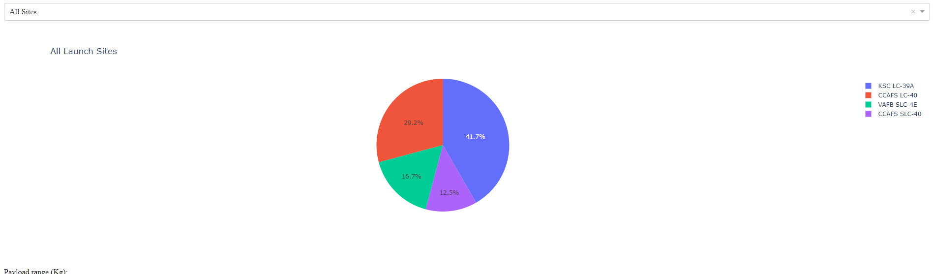
Launch Success Count For All Sites
The important elements:
Dropdown list to find the launches
Dcc.graph()
Plotly express pie for plot pie chart
Callback to configure dropdown as input and pie chart as output

Slide 42
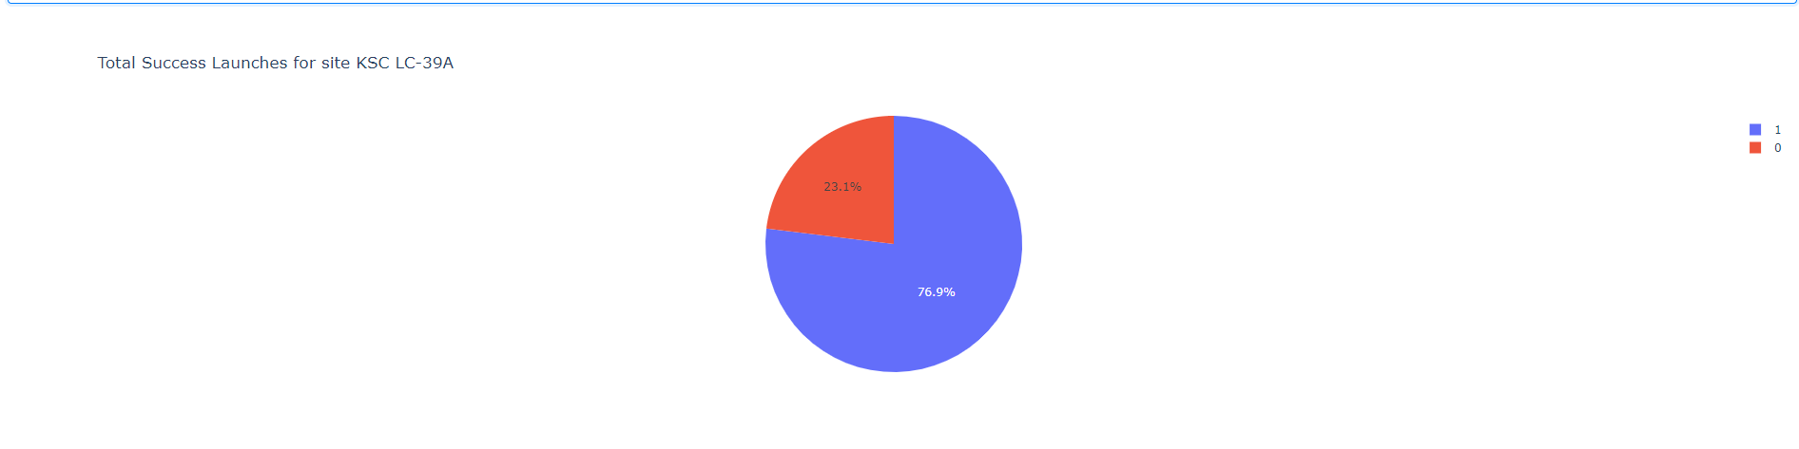
Piechart For The Launch Site With Highest Launch Success Ratio
The important elements:
Dropdown list to find the launches
Dcc.graph()
Plotly express pie for plot pie chart
Callback to configure dropdown as input and pie chart as output

Slide 43
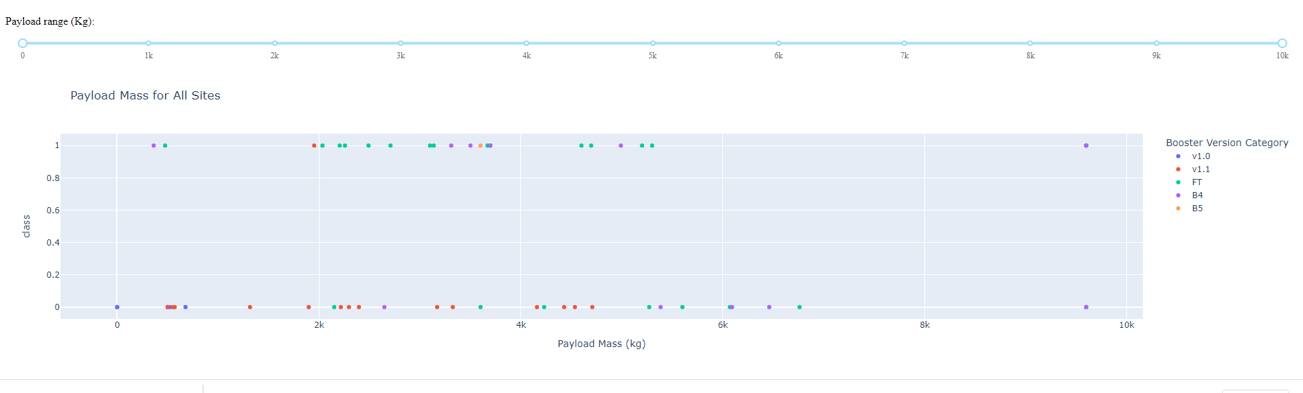
Payload Vs. Launch Outcome Scatter Plot For All Sites
The important elements:
Slider
Dcc.graph()
Plotly express scatter for plot scatter plot
Callback to configure dropdown, slider as input and pie chart as output

Slide 44

Section 5

Slide 45
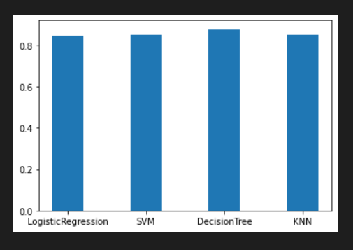
Classification Accuracy
Accuracy for each model:
Logistic Regression: 84%
SVM: 84%
Decision Tree: 87%
KNN: 84%
The best classifier model is Decision Tree

Slide 46
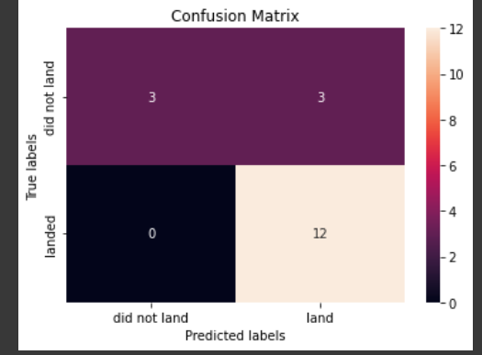
Confusion Matrix of Decision Tree

Slide 47
Conclusions
We can make a prediction how much cost for next launches by gathering and analysis information about SPACEX parameters like payload, customers, etc
We collecting the data using SPACEX REST API and scrapping
Wrangling the data to process it
Using SQL and visualize the data to analyze the data
Make an interactive dashboard to visualize better and folium to visualize data in map
Using 4 classifier model and got that the best classifier model is Decision Tree with 87% of accuracy

Slide 48


